Slide 1
Vision Transformer With Attentive Pooling for Robust Facial Expression Recognition
Doan Nguyen Tran Hoan 21520239
Nguyen Quoc Truong 21521604

Slide 2
Table of Contents
01
Introduction
02
Methodology
03
Dataset
04
Experiments

Slide 3
Introduction

Slide 4
Problem Description
FER (Facial expression recognition) is a computer vision task aimed at identifying and categorizing emotional expressions depicted on a human face.

Slide 5
Abstraction
FER in the wild is an extremely challenging task
Attentive pooling (AP) modules to pool noisy features directly
The AP modules include Attentive Patch Pooling (APP) and Attentive Token Pooling (ATP)

Slide 6
Motivation

Slide 7




Healthcare
Education
Crime detection
Business

Slide 8

Input
Output
Happy
Digital image of face (eyes, nose, mouth)
Labeled training set (labeled face image)
String represent emotion (labeled training set)

Slide 9
Challenges

Slide 10
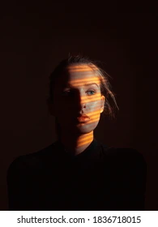

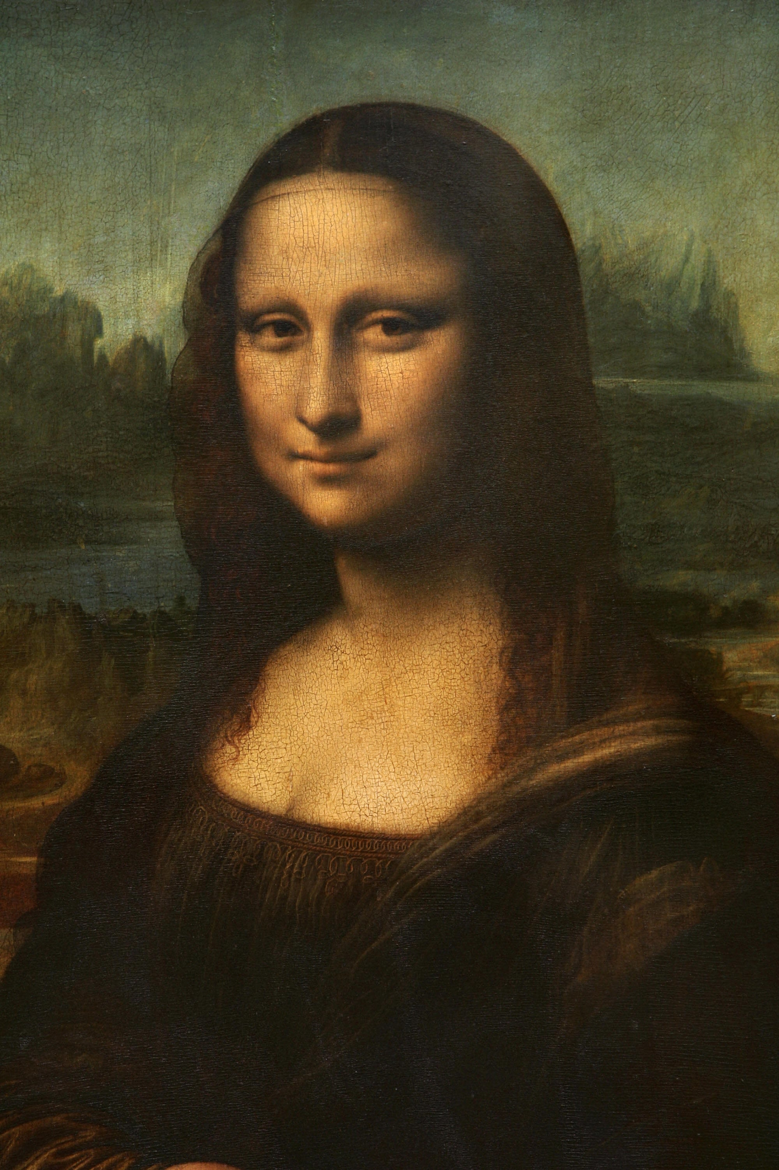
Illumination
Resolution
Multi-Expression

Slide 11
02. Methodology

Slide 12
Vision Transformer (ViT)

Slide 13
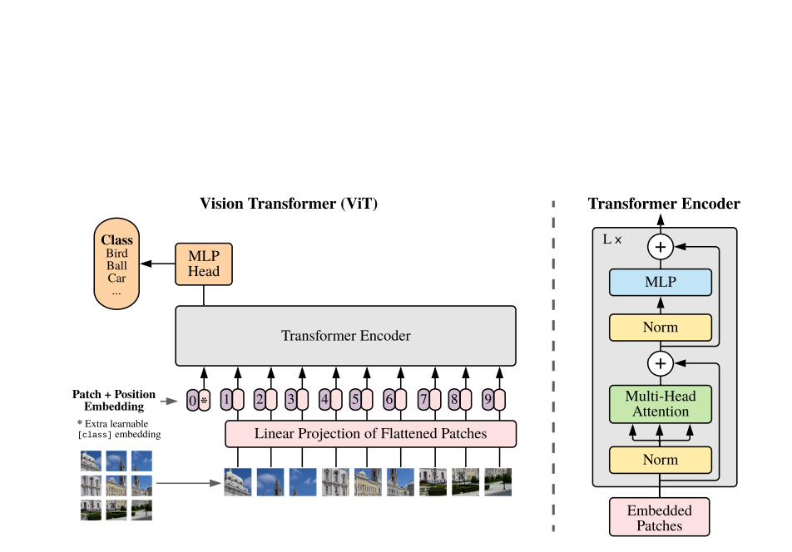

Slide 14
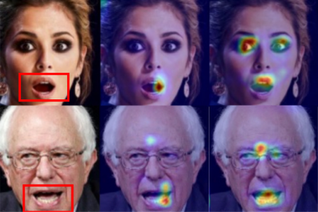
Attention map of ViT-FER vs TransFER

Slide 15
Why do we still compute noisy features even though we have already known they are noises ?

Slide 16
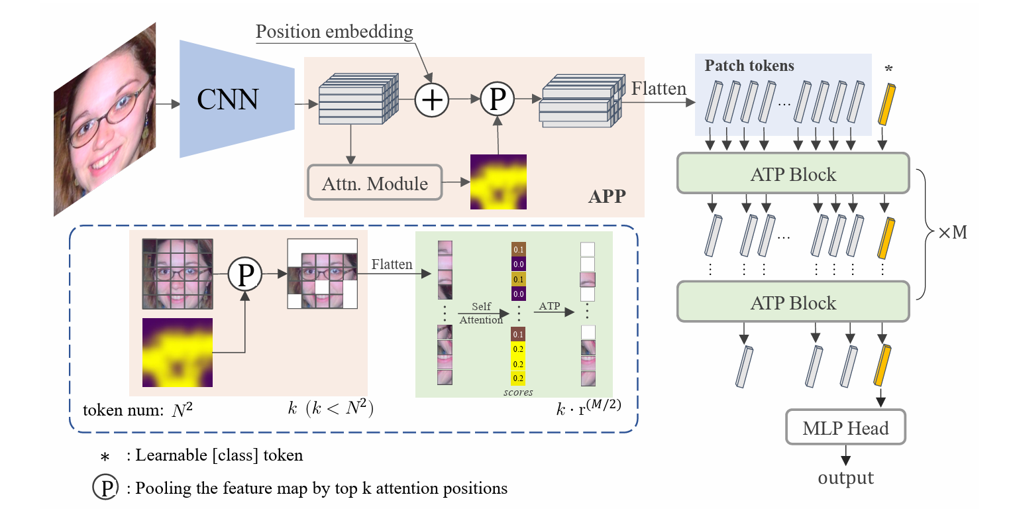

Slide 17
Attentive Patch Pooling
Locate informative areas
Drop the uninformative ones
-> boost recognition performance
Input: attention maps
Selects the top-k most important patches from the total HxW patches.
APP

Slide 18
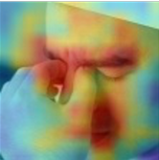
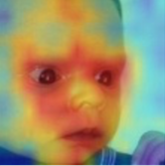

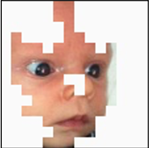
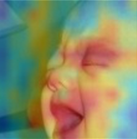
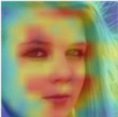
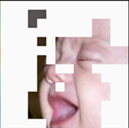
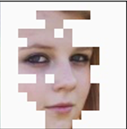
Attention maps in TransFER
Attentive pooling results of APP

Slide 19
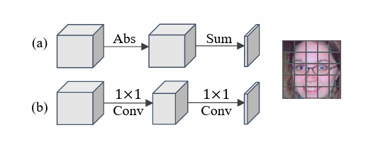
POOLING CRITERION OF APP

Slide 21
Attentive Token Pooling
ATP Block is utilized to explore the relationship among selected patches in a global scope
ATP pay attention to the top-k relevant tokens
Keep_num = [r*input_token_number]
ATP

Slide 22
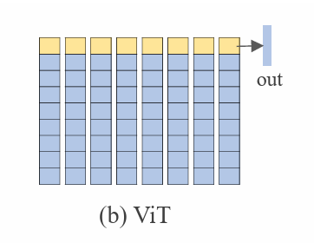
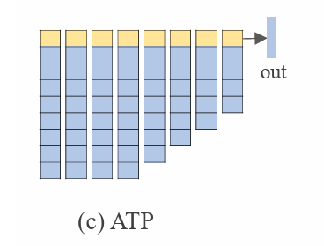

Slide 23
03. Dataset

Slide 24
Dataset
The data contains 29,672 real-world facial images.
Two different subsets: single-label subset and two-tab subset.
RAF-DB
(Real-world Affective Faces Databases)

Slide 25
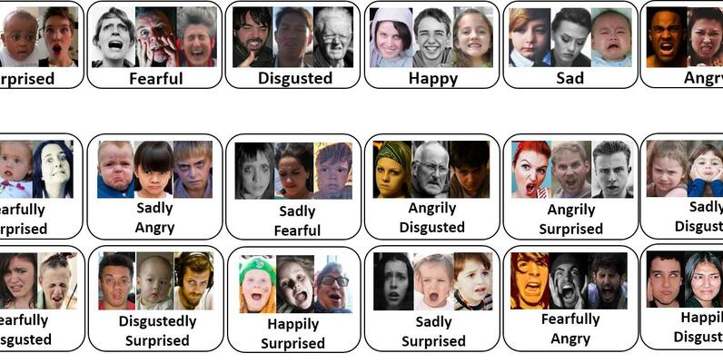

Slide 26
RAF - Database dataset

Slide 27
Dataset in practice
In experiments, the basic annotation images are utilized.
Training set: 12,271 images
Test set: 3,068 images
The dataset consists 6 expression (sadness, happiness, fear, anger, surprise, disgust) and neutral.
Single-label subset

Slide 28
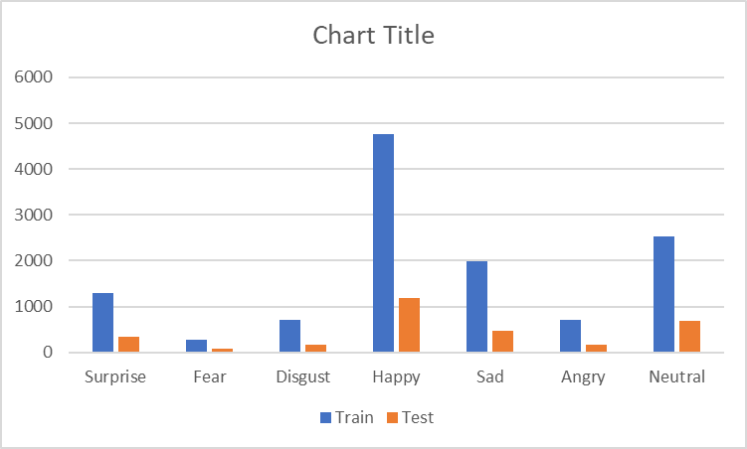
Distribution of emotion in each dataset

Slide 29
04. Experiments

Slide 30
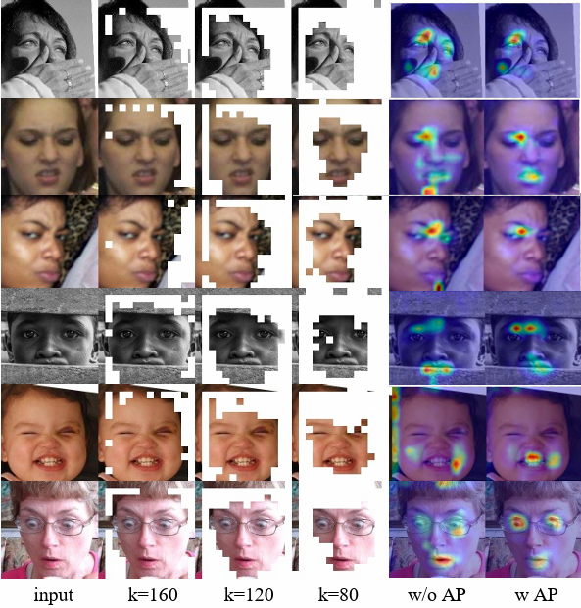
Visualization of attention maps in complex conditions

Slide 31
Results
Method | RAF-DB
DLP-CNN gACNN IPA2LT LDL-ALSG RAN CovPool SCN DLN DACL KTN EfficientFace PAT-Res101 + attr FDRL PT | 80.89 85.07 86.77 85.53 86.90 87.00 87.03 86.40 87.78 88.07 88.36 88.43 89.47 89.57
VTFF* MViT* TransFER* | 88.14 88.62 90.91
APViT* | 91.98

Slide 32
Confusion Matrix of APViT on RAF-DB
T/P | Anger | Disgust | Fear | Sadness | Happiness | Surprise | Neutral
Anger | 0.86 | 0.06 | 0.00 | 0.01 | 0.01 | 0.02 | 0.04
Disgust | 0.02 | 0.74 | 0.02 | 0.06 | 0.06 | 0.03 | 0.08
Fear | 0.03 | 0.00 | 0.73 | 0.04 | 0.04 | 0.16 | 0.00
Sadness | 0.01 | 0.02 | 0.01 | 0.89 | 0.02 | 0.01 | 0.05
Happiness | 0.00 | 0.01 | 0.00 | 0.00 | 0.97 | 0.01 | 0.01
Surprise | 0.01 | 0.02 | 0.01 | 0.01 | 0.00 | 0.93 | 0.02
Neutral | 0.00 | 0.00 | 0.00 | 0.04 | 0.02 | 0.02 | 0.92

Slide 33
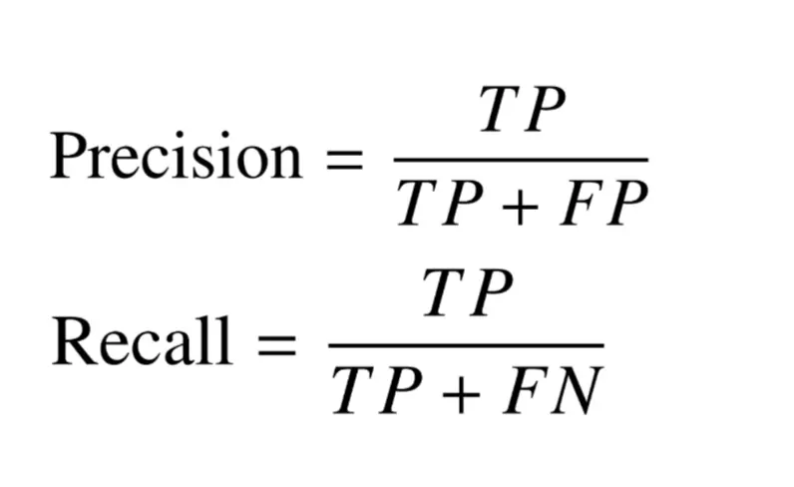
Metric
Precision:
Recall:
Precision, Recall

Slide 34
DEMO

Slide 35
Conclude
Two Attentive Pooling (AP) modules with Vision Transformer
APViT model outperforms the state-of-the-art methods

Slide 36



Do you have any questions?
Please contact us

Slide 37
Thanks for your listening

